Slide 1


WELCOME TO AZURE DEVOPS OVERVIEW

Slide 2

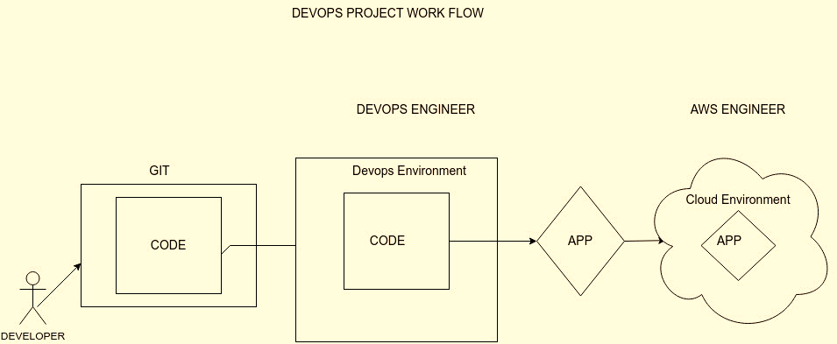
DEVOPS PROJECT WORK FLOW
AZURE ENGINER

Slide 3
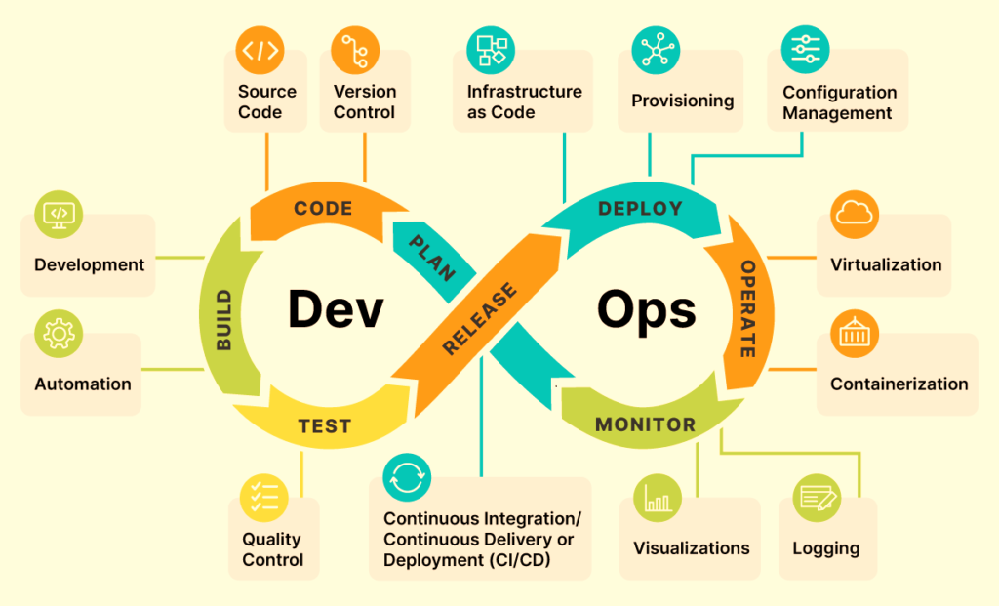
DEVOPS ENVIRONMENT

Slide 4
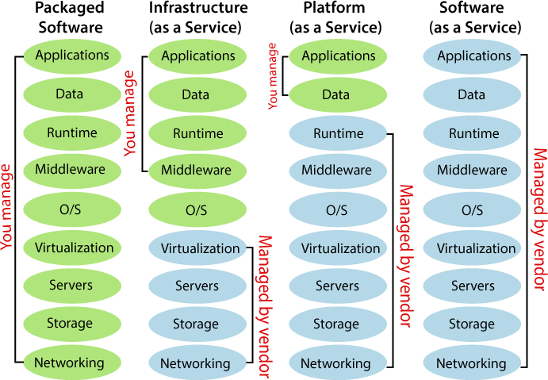
Cloud Services

